Slide 1


[COMPANY] USB and Removable Media Policy
Welcome to our comprehensive guide on USB and removable media security protocols. This presentation outlines the critical policies and procedures designed to prevent unauthorized data exfiltration, block the introduction of malicious code, and maintain the integrity and confidentiality of our organization's Controlled Unclassified Information (CUI).
These guidelines ensure we remain compliant with security requirements while facilitating necessary business operations. All employees must understand and adhere to these protocols to protect our sensitive information assets.
by Adan Lopez

Slide 2
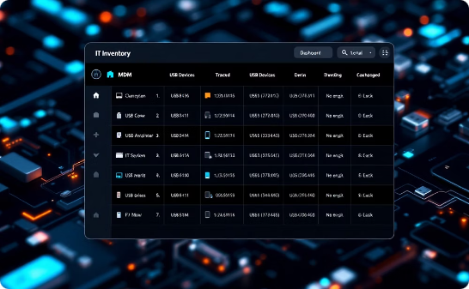


Authorization and Inventory Requirements
Centralized Inventory System
Authorized Use Cases
Formal Approval Process
All portable storage devices are tracked in a central inventory (Intune MDM). This provides full visibility of approved devices throughout their lifecycle.
Specific business functions are pre-authorized for removable media, such as ME work instructions, cameras, 3D printers, and IT support activities.
All USB storage devices and use cases that are not pre-authorized must be approved by management or the IT Department.

Slide 3

External System Restrictions
Explicit Authorization Required
Use of portable media on external non-CUI systems must be authorized explicitly by the IT Manager through a formal ticketing system. Each request is evaluated based on business need and security risk.
Personal Device Prohibition
The organization strictly prohibits the use of personally-owned portable storage devices on any company system. This eliminates risks associated with unmanaged devices entering our network.
Information Control Policy
Our comprehensive Information Control Policy defines specific limitations on the use of portable storage devices on external systems, including permitted data types and handling procedures.
4
Removal From Premises Prohibited
Removal of portable storage media from company premises is strictly prohibited without written authorization by the IT Manager.

Slide 4

Encryption and Marking Requirements
FIPS 140-2 Validated Encryption
The organization mandates FIPS 140-2 validated encryption on all portable storage containing CUI. Exceptions are only permitted in cases where encryption is not supported on specific machinery or equipment, which must be documented.
Appropriate CUI Markings
All CUI stored on portable storage devices must be appropriately marked according to our Information Control Policy. This includes clear header/footer designations and document-level markings to prevent accidental disclosure.
Physical Security When Not In Use
The Information Control Policy mandates physical security for portable storage devices containing CUI when not in use. Devices must be stored in locked cabinets or secure areas with controlled access.

Slide 5






Device Control Implementation
Deny-by-Default Approach
Connection to computers via USB ports is denied by default
Organization-Owned Devices Only
Only company-owned or explicitly authorized USB devices permitted
Central IT Authorization/Control
Control and monitoring systems enforce restrictions and alert IT of unauthorized portable media.
Our technical implementation establishes a robust defense against unauthorized removable media. The deny-by-default approach provides protection against opportunistic data exfiltration attempts while maintaining business functionality through authorized exceptions.
Intune's Endpoint Security Device Control delivers centralized policy enforcement, allowing us to implement granular permissions based on specific device characteristics and business requirements.

Slide 6

Device Authorization Process
Serial Number Identification
Device Naming Convention
Allowed devices are assigned owner name and date. This naming convention facilitates auditing of approved devices and annual review and reauthorization.
Approved devices are explicitly allowed by IT within the security system. This provides definitive identification of each authorized device and prevents unauthorized devices.
Periodic Review
Each year, all devices must be requested and approved again in the Help Desk ticketing system.

Slide 7








Physical Labeling Requirements
Owner's Name
"Contains CUI" Marking
Clear identification of the responsible employee ensures accountability and proper tracking
Visual indicator reminds users of the sensitive nature of the device contents
Consistent Application
Authorization Date
All authorized devices must maintain proper labeling throughout their lifecycle
Date of approval helps enforce the annual reauthorization requirement
Physical labeling provides an immediate visual indicator of device authorization status and handling requirements. The standardized labeling system helps employees quickly identify approved devices and reinforces the sensitive nature of the data they may contain.

Slide 8




Enforcement and Monitoring
Personal Device Prohibition
Comprehensive Logging
The use of personally owned or unapproved removable media on organizational systems is strictly prohibited. Any unauthorized device detected attempting to connect will be blocked automatically and reported for security review.
All use of removable media is logged with detailed information including user, device, timestamp, and data accessed. These logs are preserved for audit purposes and security investigations.
Real-Time Alerts
Regular Compliance Audits
Security systems generate immediate alerts when unauthorized devices attempt connection or when unusual data transfer patterns are detected, enabling rapid response to potential security incidents.
The IT security team conducts periodic reviews of removable media usage patterns, whitelisted devices, and policy exceptions to ensure ongoing alignment with security requirements.

